Slide 1


Kubernetes on Azure
Workshop

Slide 2
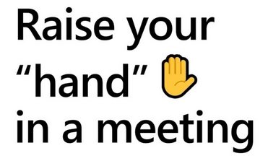
Tips
Mic op mute
Questions: “Raise Hand”
Bad connection? Disable incoming video!

Slide 3

The demo app
Shakespearean Dating
Angular 11 Front End
Match making API
.NET of Spring Boot Back End
MongoDB

Slide 4
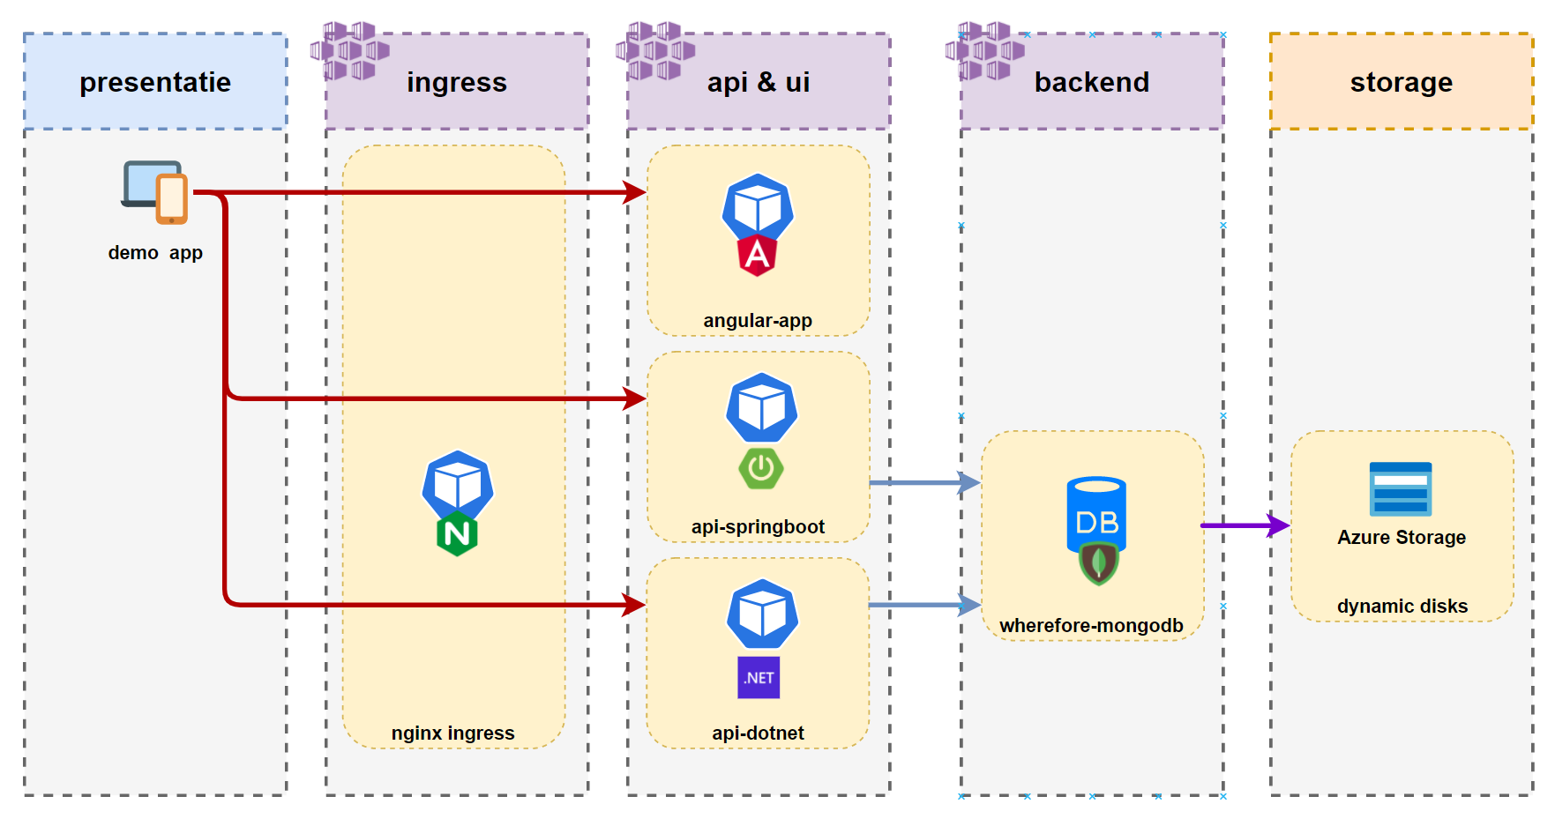
Architecture

Slide 5
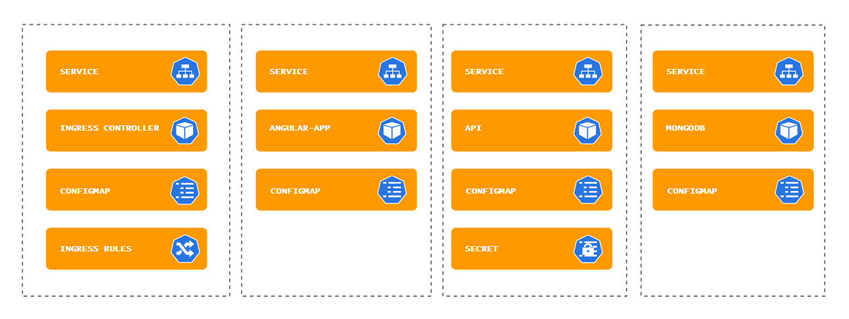
Components

Slide 6
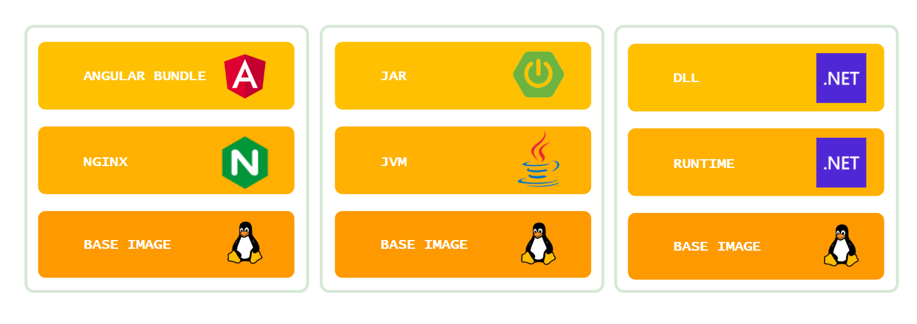
Images

Slide 7
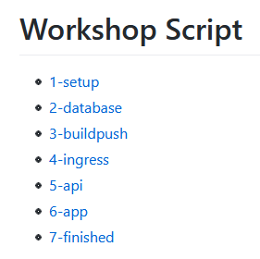
Workshop Script

